Slide 1
EQ2321
Speech and Audio Processing
Project 1
Yuqi Zheng, Jingxuan Mao
Feb 17, 2022

Slide 2

1
Bandwidth of Speech
Intelligibility: We start hearing what is said at cut-off frequency 1800 Hz for male, 2000 Hz for female.
Degradation: We start hearing a degradation at cut-off frequency 2300 Hz for male, 2800 Hz for female.
Because human speech is almost perfectly recognizable at the frequency of 4000Hz. 8000Hz is larger than twice of the degradation threshold of male or female voice. With this sampling frequency, the voice of the speaker can be transferred without degradation.

Slide 3
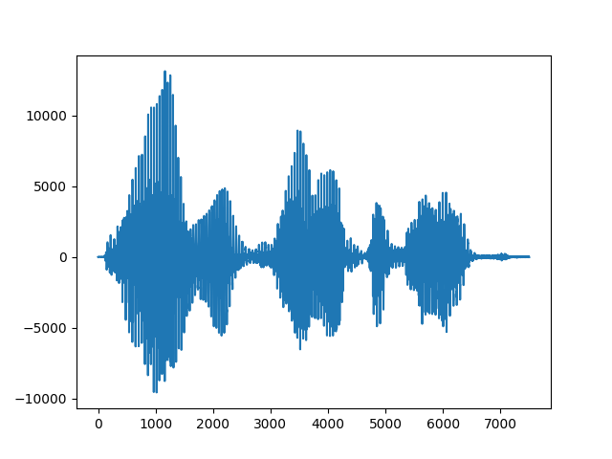
2
Voiced and Unvoiced Speech Sounds
1. & 2. Time plot.
Highest
Voiced
Unvoiced
Lowest

Slide 4
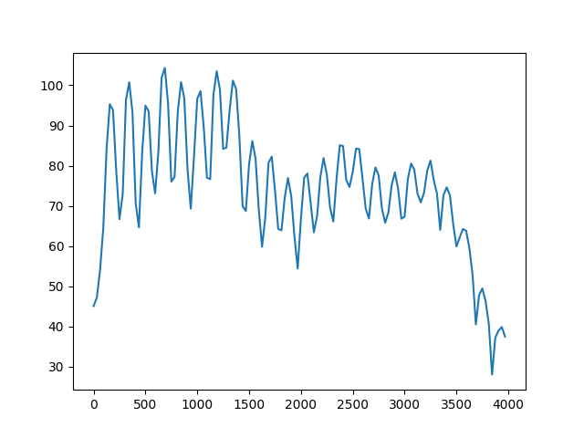
2
Voiced and Unvoiced Speech Sounds
Spectrum for a voiced frame.
x = d[‘male_short’]
s = 1000
N = 256
fs = 8000

Slide 5
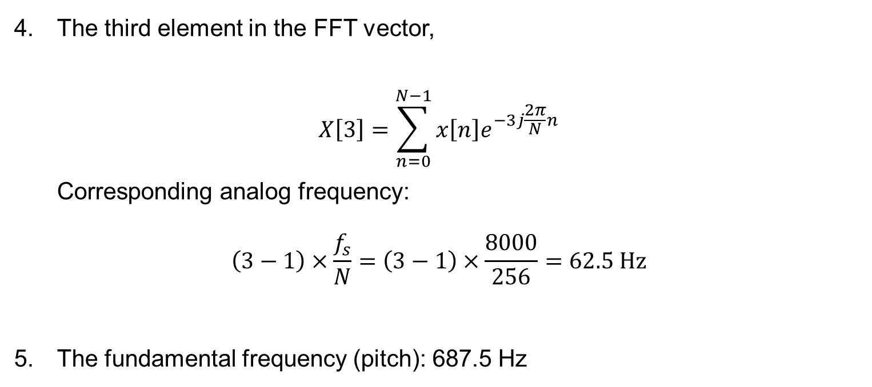
2
Voiced and Unvoiced Speech Sounds
The third element in the FFT vector,
$$X\left[3\right]=\sum_{n=0}^{N−1}{x\left[n\right]e^{−3j\frac{2π}{N}n}}$$
Corresponding analog frequency:
$$\left(3−1\right)×\frac{f_{s}}{N}=\left(3−1\right)×\frac{8000}{256}=62.5 Hz$$
The fundamental frequency (pitch): 687.5 Hz

Slide 6
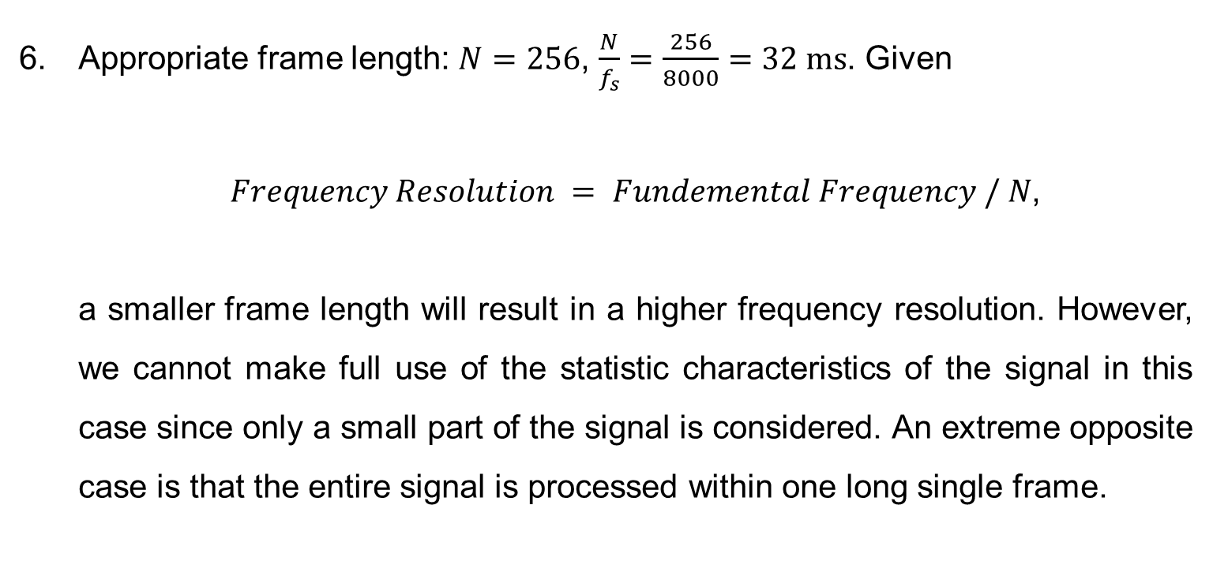
2
Voiced and Unvoiced Speech Sounds
Appropriate frame length: $N=256$, $\frac{N}{f_{s}}=\frac{256}{8000}=32 ms$. Given
$Frequency Resolution = Fundemental Frequency / N$,
a smaller frame length will result in a higher frequency resolution. However, we cannot make full use of the statistic characteristics of the signal in this case since only a small part of the signal is considered. An extreme opposite case is that the entire signal is processed within one long single frame.

Slide 7
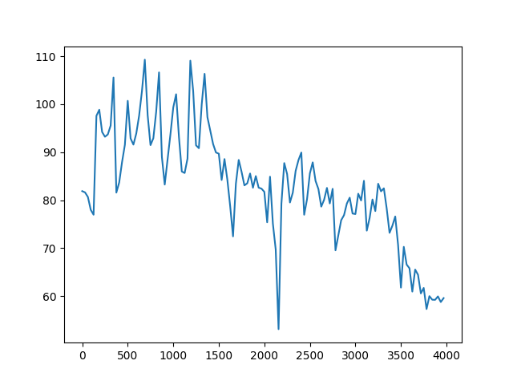
2
Voiced and Unvoiced Speech Sounds
Replace hanning window with a rectangular window.
Hanning Window
Rectangular Window
We can see that the application of the rectangular window results in a relatively higher frequency resolution and larger fluctuations.

Slide 8
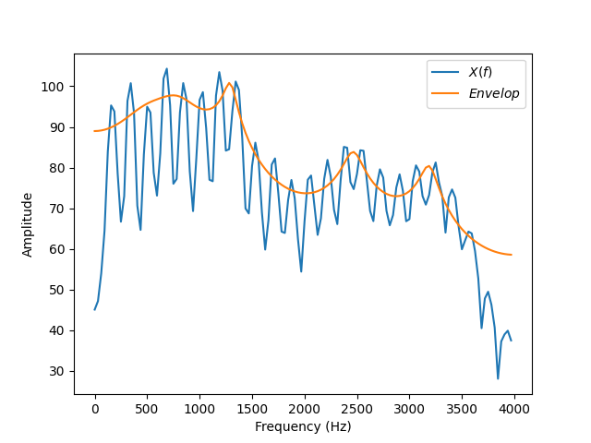
2
Voiced and Unvoiced Speech Sounds
The LP envelope of the spectrum.
M = 10

Slide 9
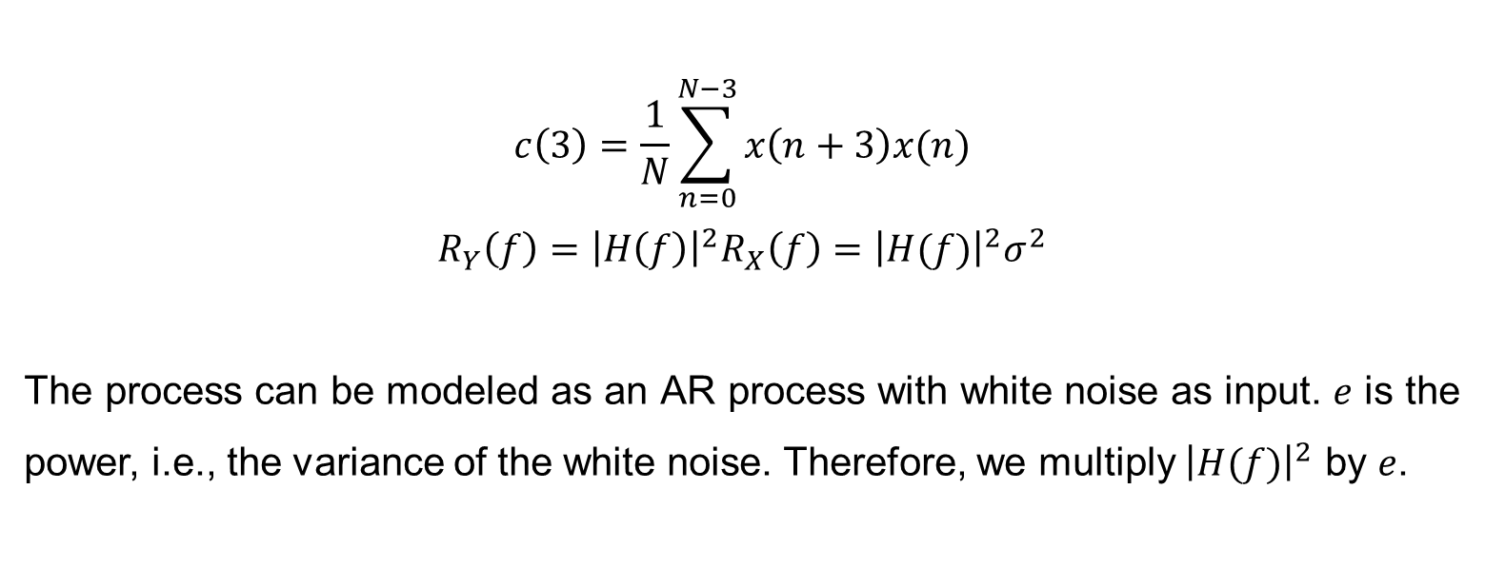
2
Voiced and Unvoiced Speech Sounds
$$c\left(3\right)=\frac{1}{N}\sum_{n=0}^{N−3}{x\left(n+3\right)x(n)}$$
$$R_{Y}\left(f\right)={\left|H\left(f\right)\right|}^{2}R_{X}\left(f\right)={\left|H(f)\right|}^{2}σ^{2}$$
The process can be modeled as an AR process with white noise as input. $e$ is the power, i.e., the variance of the white noise. Therefore, we multiply ${\left|H(f)\right|}^{2}$ by $e$.
9.

Slide 10
2
Voiced and Unvoiced Speech Sounds
The prediction order M = 10.
Vowels usually have four formants, consistent with the 4 peaks as we can observe in the PSD. Therefore, the order of the AR process should be 8. Here, we choose a slightly larger order to be more precise.

Slide 11
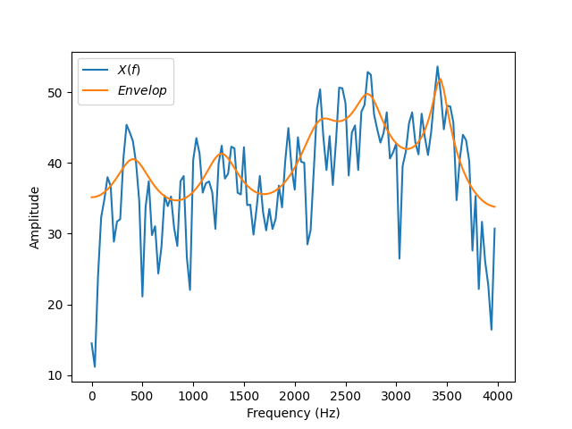
2
Voiced and Unvoiced Speech Sounds
Spectrum for an unvoiced frame.
x = d[‘male_short’]
s = 7200
N = 256
fs = 8000
M = 10

Slide 12
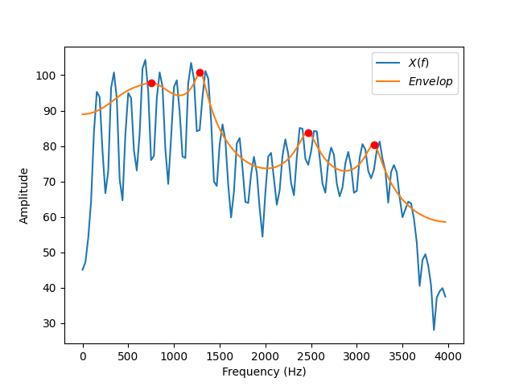
3
Formants
We can see that
F1 = 750 Hz,
F2 = 1280 Hz,
F3 = 2470 Hz.
The vowel is closest to “aa” (730|1090|2240).

Slide 13
3
Formants
How are pitch and formant frequencies related?
Pitch is the fundamental frequency of vibration of the vocal folds. They vibrate quasi-periodically only for voiced phonemes. For unvoiced sounds, there is nothing called pitch.
The formant frequencies are due to the frequency shaping of the signal from the vocal folds by the vocal tract. Each formant corresponds to a resonance in the vocal tract. Formants exist for both voiced and unvoiced sounds.[1]

Slide 14
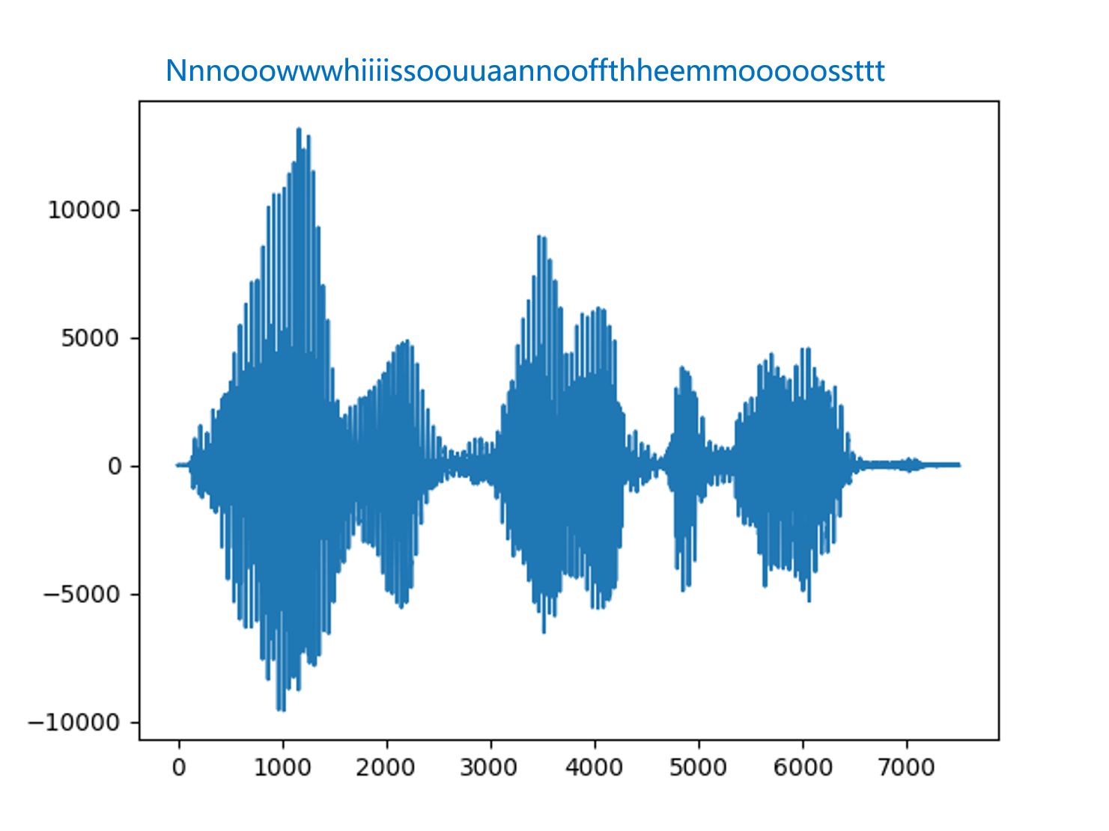
4
Phonemes and Allophones

Slide 15
4
Phonemes and Allophones
Consonants can have formant frequencies. Voiced consonants such as nasals and laterals have specific vocal tract shapes that are characterized by the frequencies of the formants. Other consonants such as stops and approximants (semivowels) can also be characterized in part by the formants of their vocal tract shapes.[2]
A diphthong is a sound formed by the combination of two vowels in a single syllable, in which the sound begins as one vowel and moves towards another(as in coin, loud, and side).[3]
There are 44 phenomes in English.

Slide 16
4
Phonemes and Allophones
The term phone is used when a speech sound is considered separate from language. A phone is a unit of speech sound, which may refer to any speech sound or gesture without regard of its place in phonology of a language.
Allophones are phonetic variations of a phenome that do not change spoken word meaning. For example, the aspirated “p” in “pot” and the unaspirated “p” in “spot” are allophones of /p/.
There are two types of allophones, based on whether a phoneme must be pronounced using a specific allophone in a specific situation or whether the speaker has the unconscious freedom to choose the allophone that is used. Therefore, there’s not an exact number of allophones.[4]

Slide 17
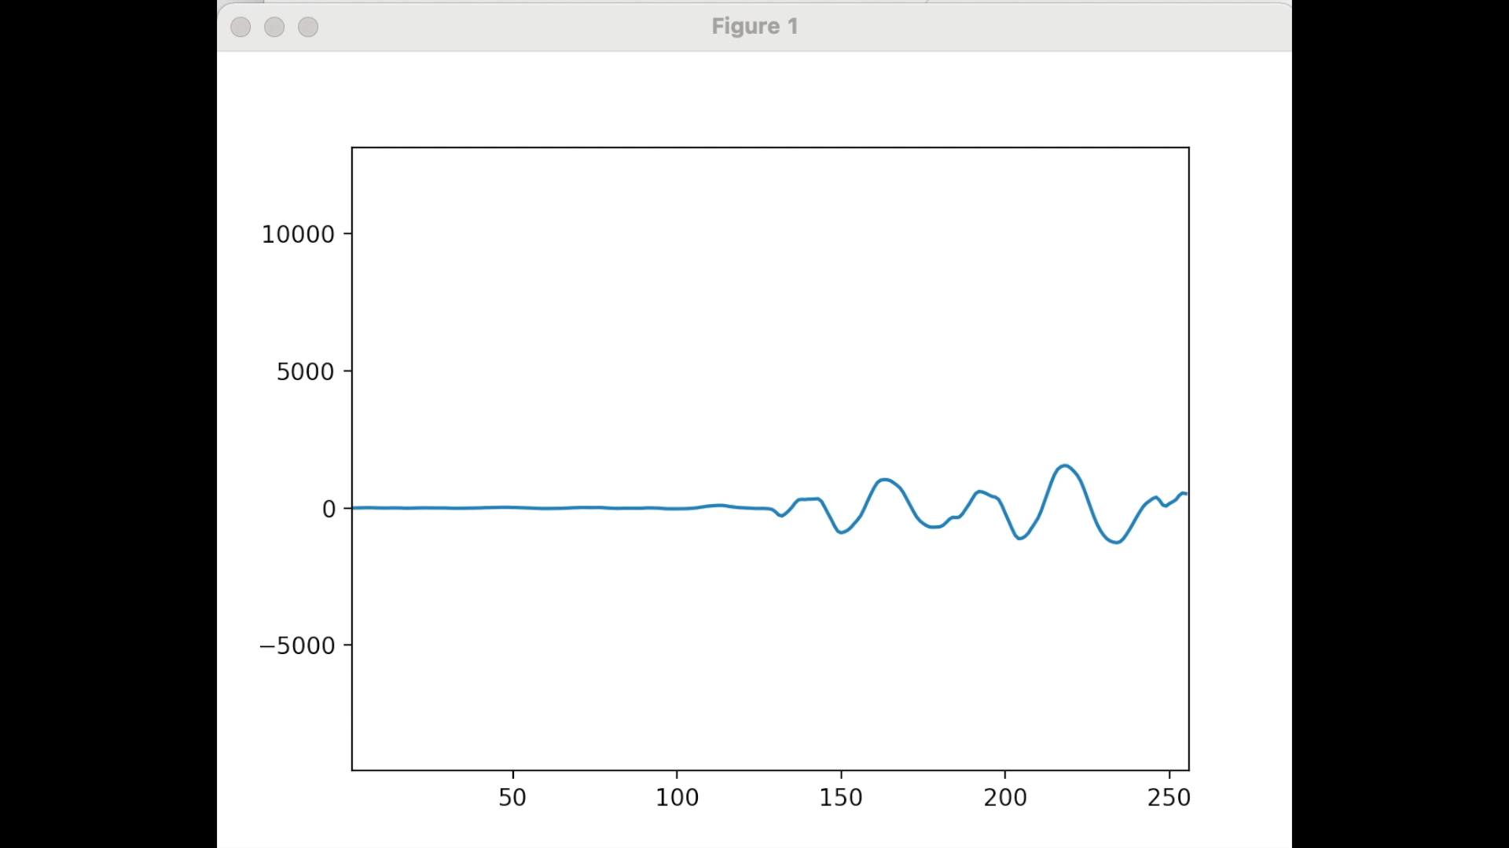
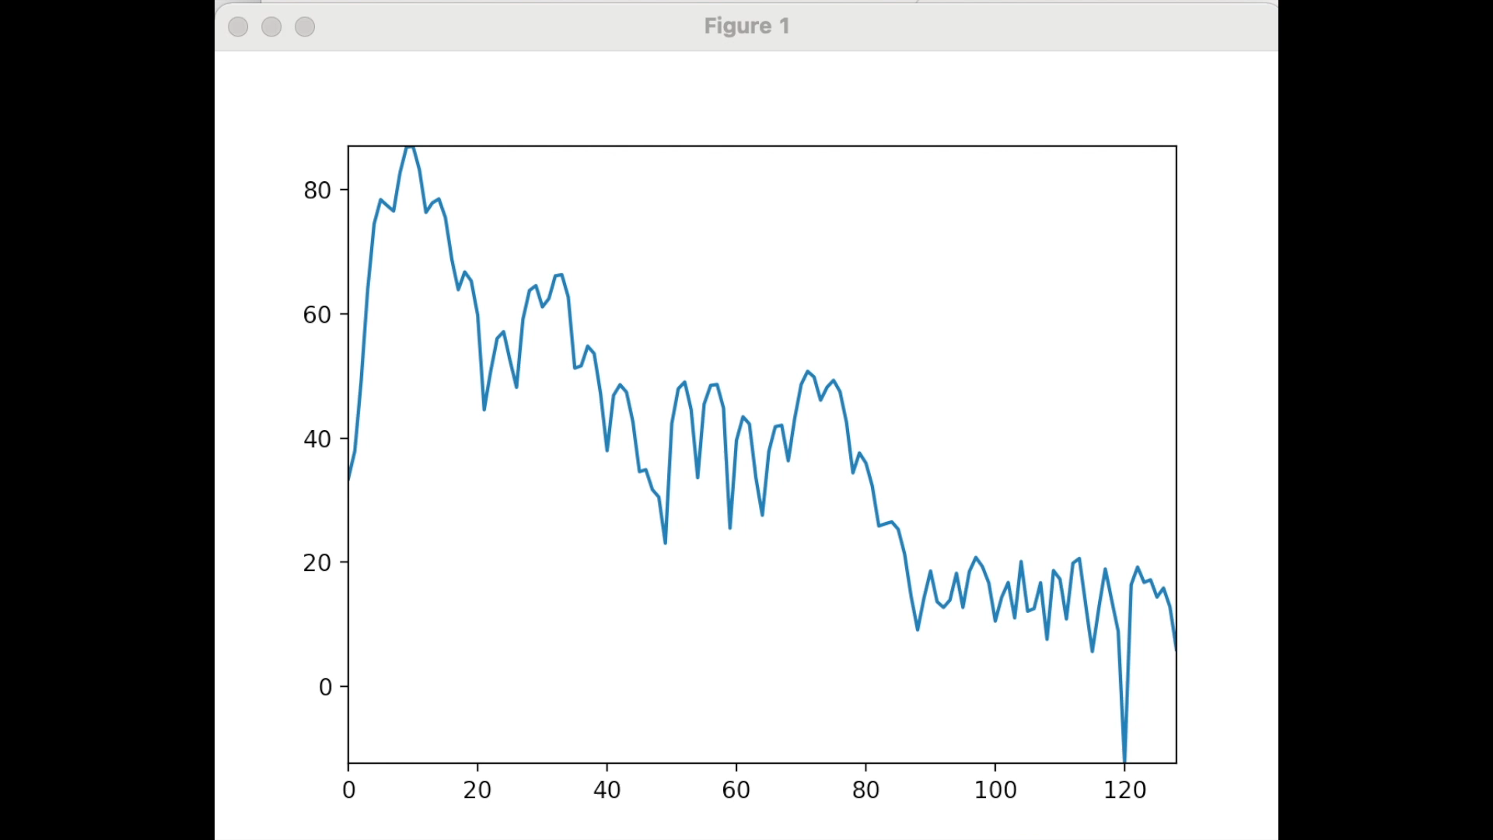
5
The Spectrogram
x = d[‘male_short’]
alen = 256
ulen = 32

Slide 18
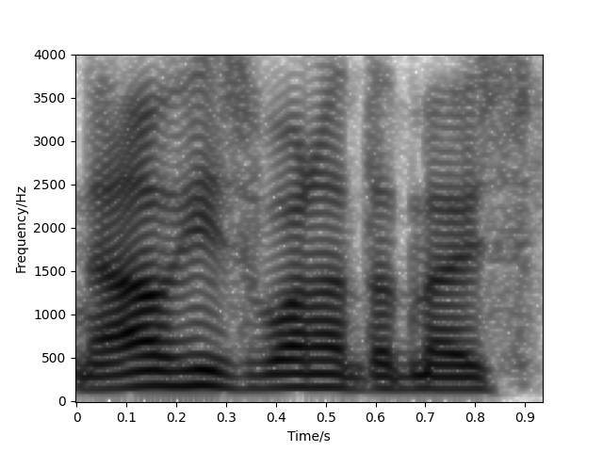
5
The Spectrogram
The classical spectrogram.
x = d[‘male_short’]
alen = 256
ulen = 32

Slide 19
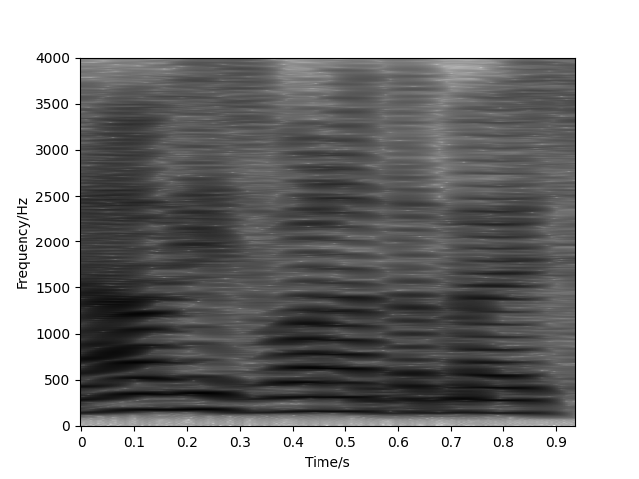
5
The Spectrogram
The narrow-band spectrogram.
x = d[‘male_short’]
alen = 1024
ulen = 32

Slide 20
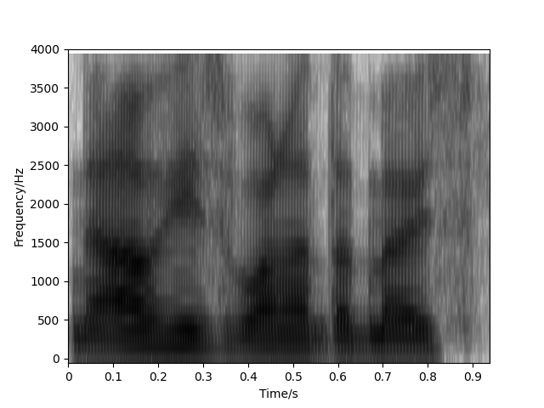
5
The Spectrogram
The wide-band spectrogram.
x = d[‘male_short’]
alen = 64
ulen = 4

Slide 21
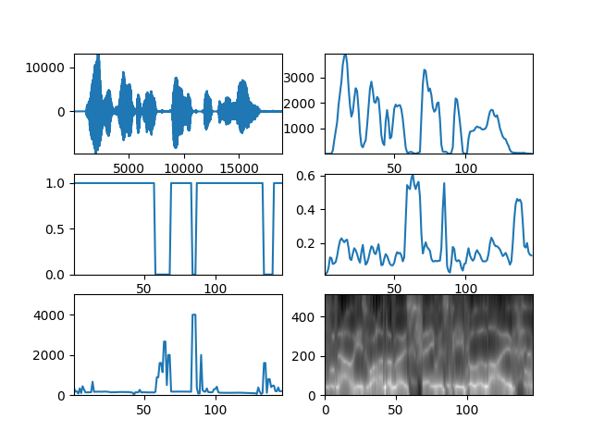
6
Speech Parameter Estimation
The wide-band spectrogram.
x = d[‘male_long’]
alen = 256
ulen = 32
M = 10

Slide 22
6
Speech Parameter Estimation
The voiced/unvoiced detection could go wrong if the sound is not clear enough. Besides, an inappropriate threshold selection can lead to detection errors. Especially, detection at the transition between voiced and unvoiced regions is prone to errors.
If the power of a harmonic is high, the harmonic frequency could be interpreted as the fundamental frequency. When it is outside the true fundamental frequency, there is “pitch doubling”. When it is interpolated between zero frequency and the true fundamental frequency, “pitch halving” occurs.

Slide 23
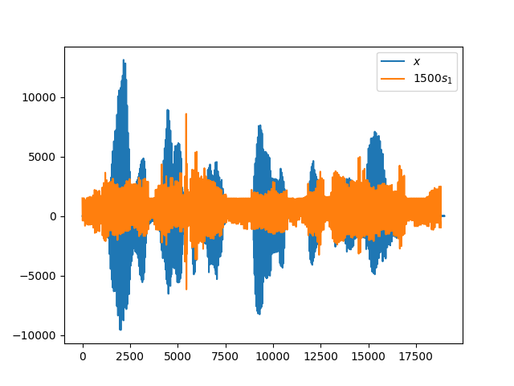
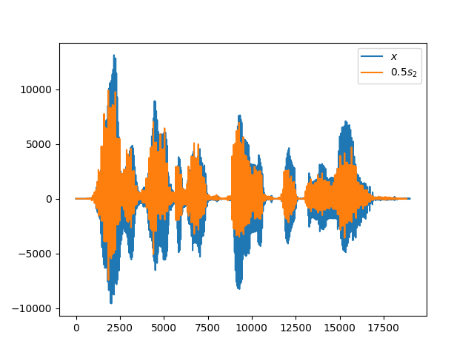

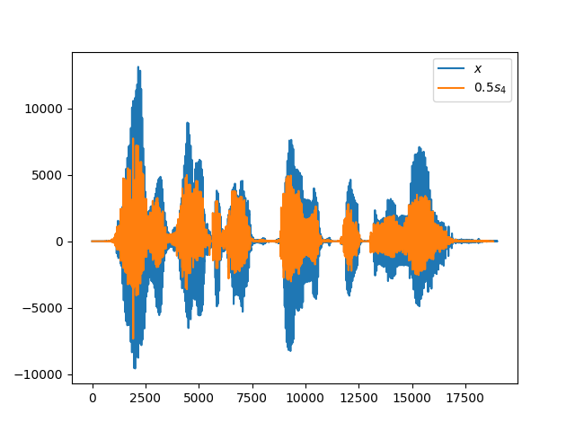
7
Vocoder
x = d[‘male_long’]
alen = 256
ulen = 32
M = 10

Slide 24
References:
[1]https://www.researchgate.net/post/What_is_the_difference_between_pitch_and_formant_frequency
[2]https://www.britannica.com/science/phonetics/Vowel-formants
[3]Definitions from Oxford Languages
[4]https://en.wikipedia.org/wiki/Allophone

